Slide 1

Economic Effects on Canadian Health and Food Consumption,
By team 3
Peerapat Phatpanichot
Justin Zhang
Riddhi Mistry
Faraz Tabatabaei

Slide 2
reasons examples:
- Economies General growth which makes most central banks to target 2% inflation rate and try to keep that
- Labour shortages due to different reasons
- Production cost increase, such as increase in energy and land costs and material shortages or an increase in material prices.
PPI: Producer price index, is a price index that measures the average changes in prices received by domestic producers for their outputice index that measures the average changes in prices received by domestic producers for their output. they use it to calculate and predict CPI which helps us calculate and predict inflation in an economy.
CPI: Consumer Price index, is and index which measures the change in prices paid by consumers for goods and services. For Canada’s CPI for example, It can contain up 80,000 items and products. It is updated every month and prioritized based on order of use and importance.

Slide 3
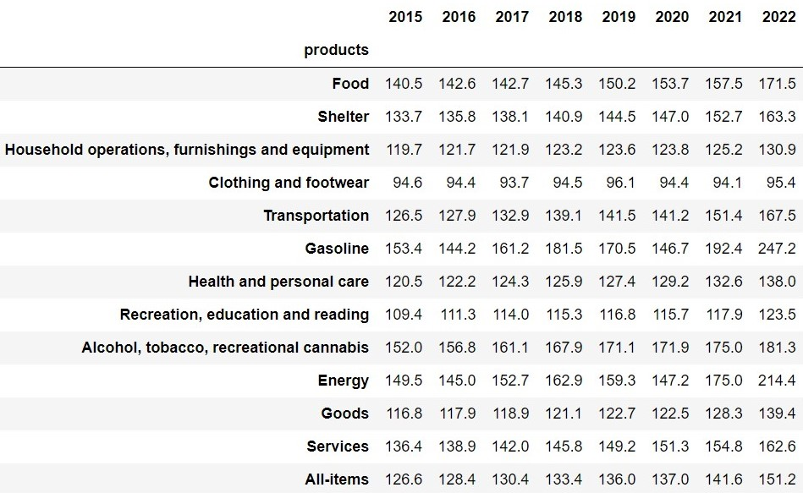
Annual CPI average per year since 2015

Slide 4
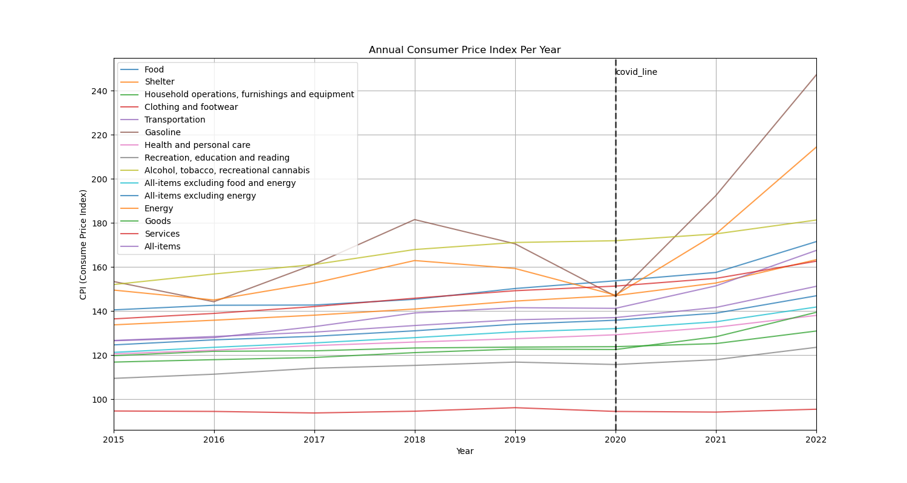

Slide 5
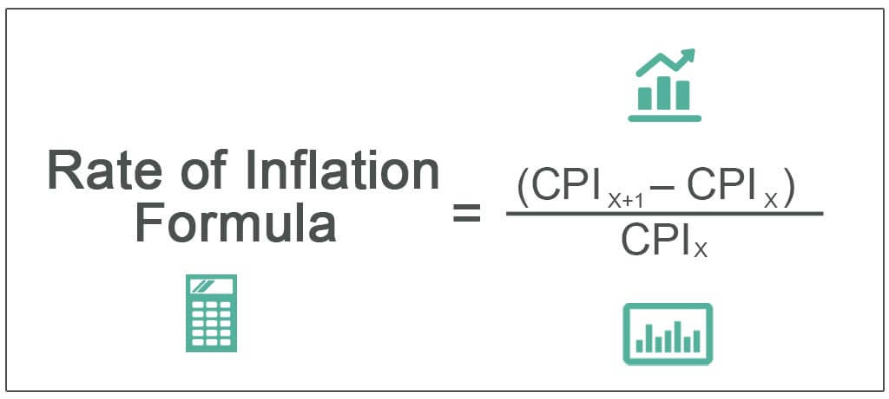

Slide 6
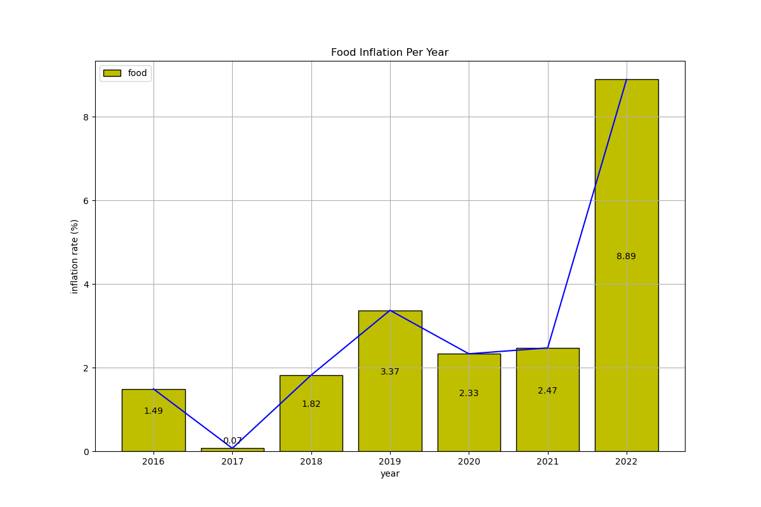

Slide 7
Canada’s Food Availability
Vs Inflation
Against the Variables; How much do we have left?

Slide 8
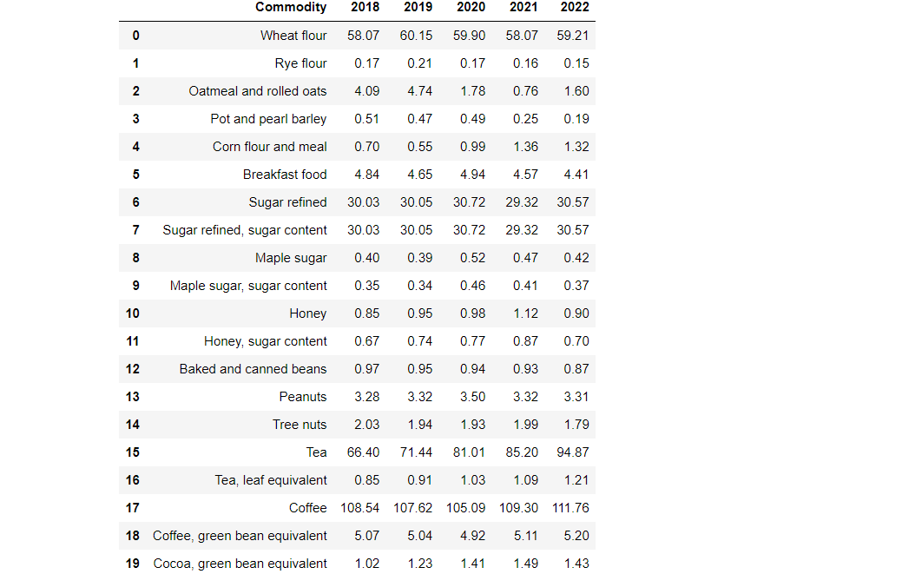

Slide 9
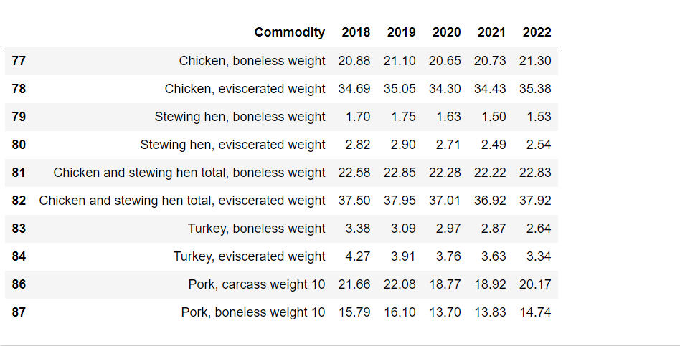

Slide 10

Is Inflation Stealing our Food?

Slide 11
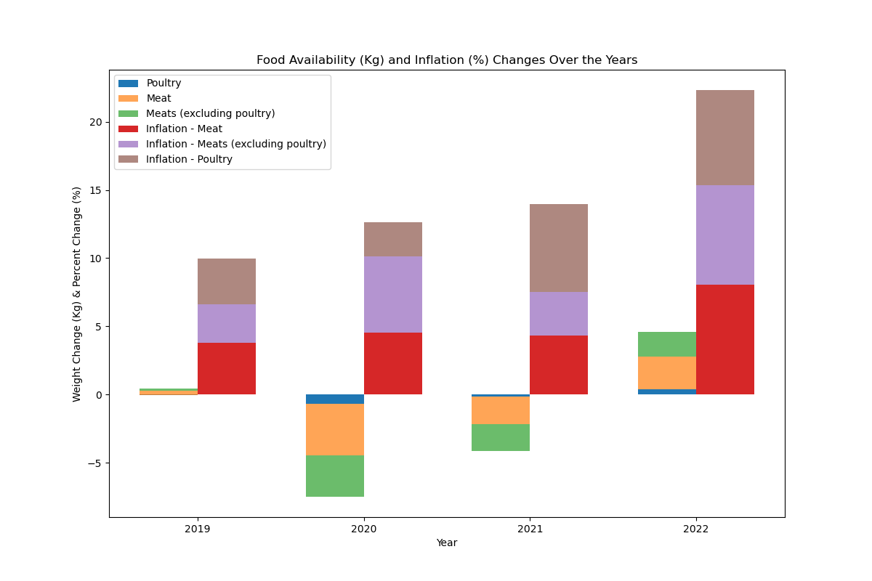

Slide 12
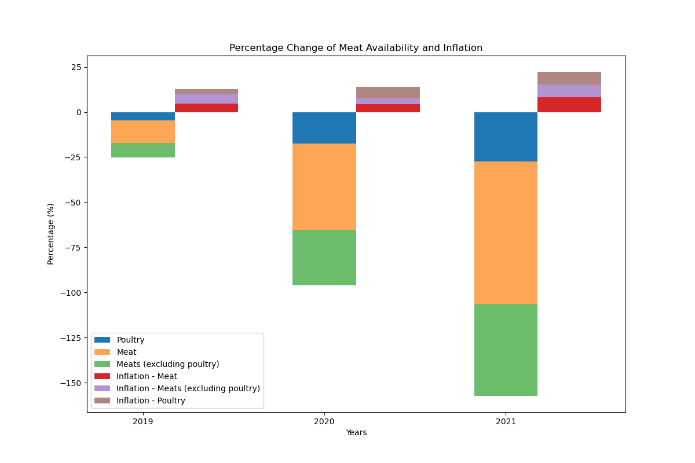

Slide 13


What does the Percentage tells us?

Slide 14

Examining Relationships Between Wellness and Food Expenditures

Slide 15

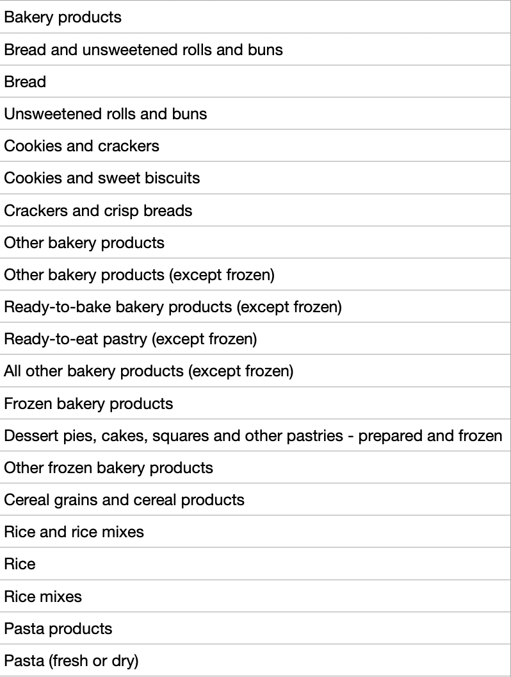
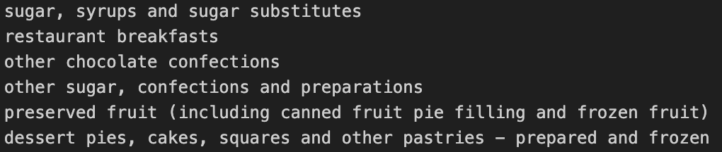

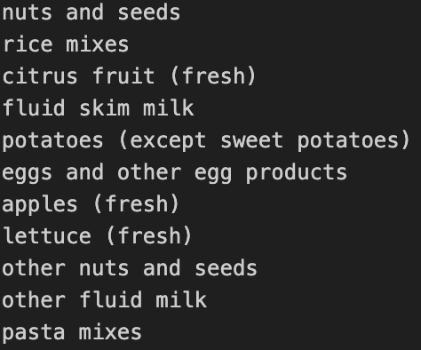
Data Processing: Classifying Food Items

Slide 16
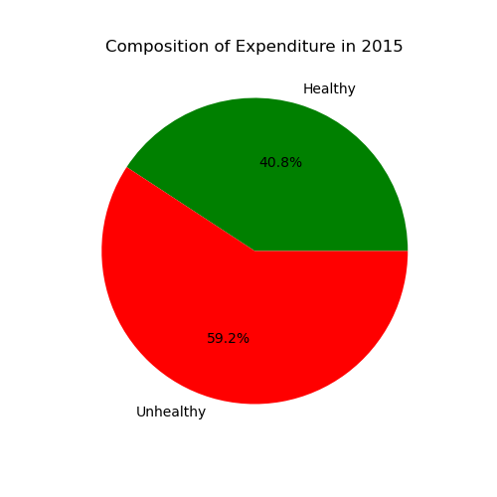


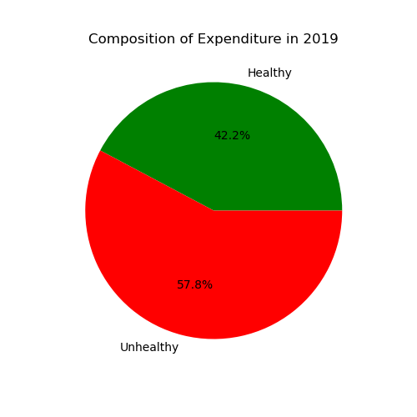
Visualizing Food Expenditures Over Time

Slide 17
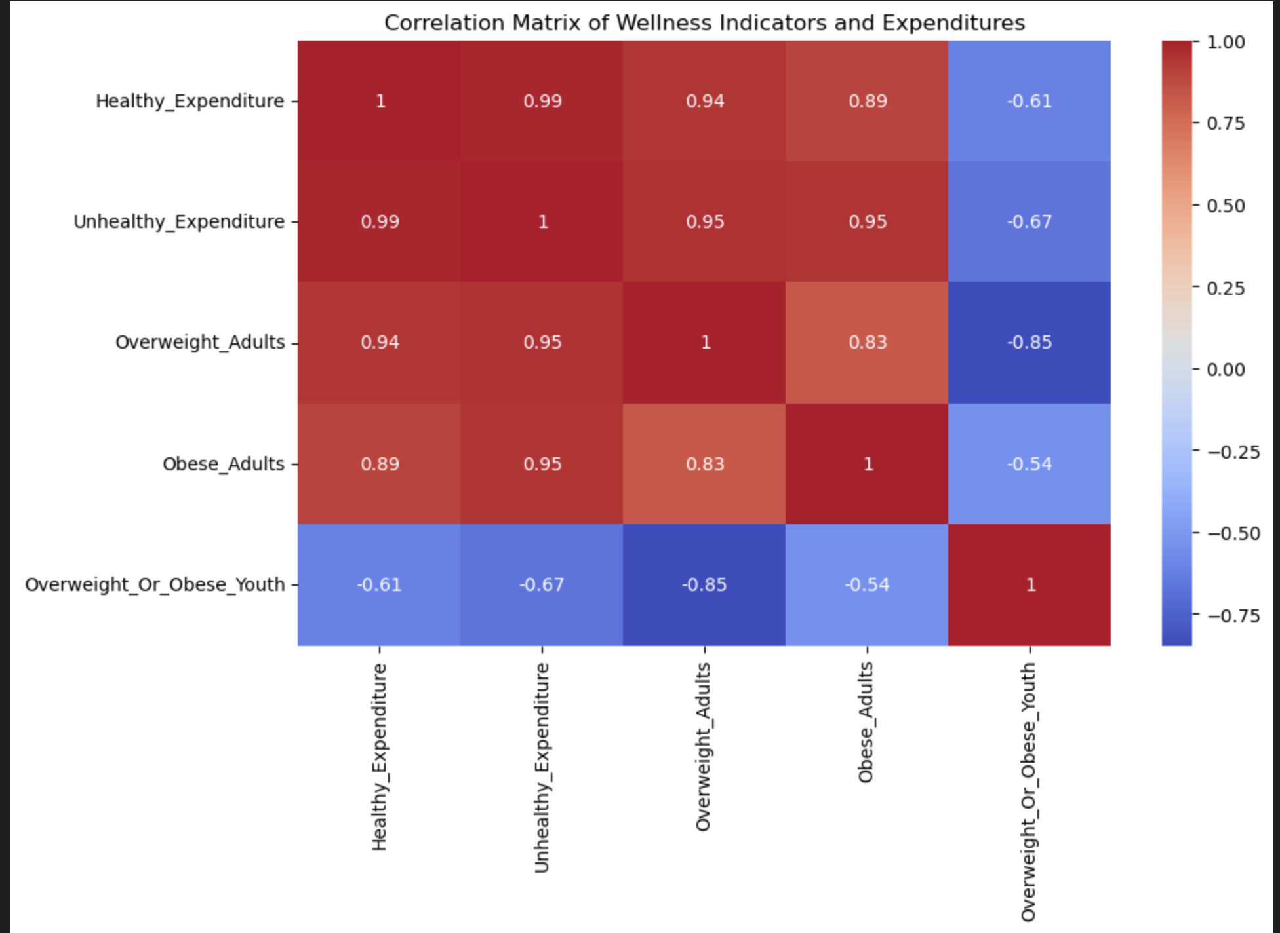
Relationships Between Wellness Indicators and Food Expenditures

Slide 18
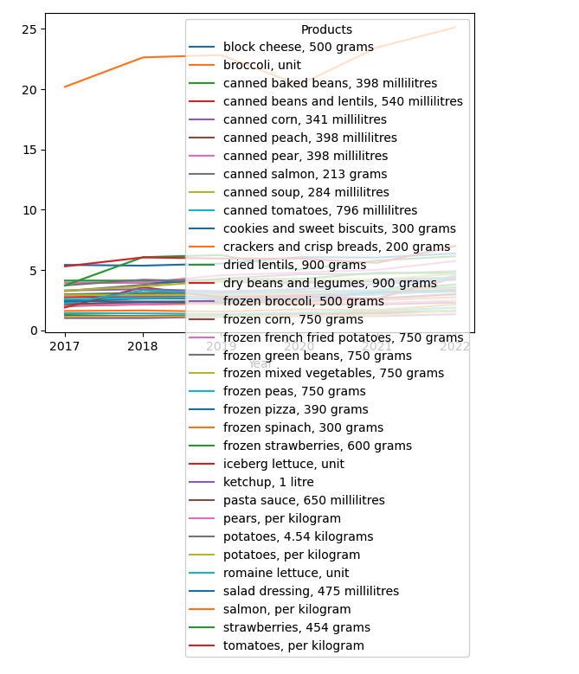
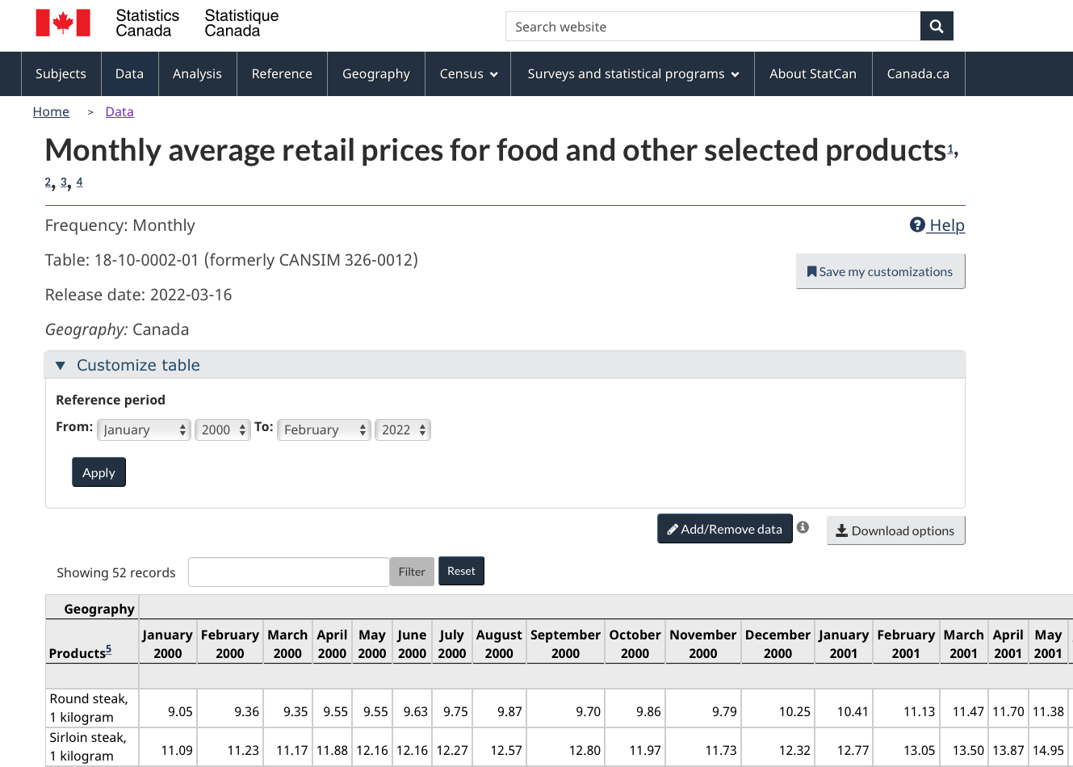
Analyzing the Dataset
Notes:
Leveraging the learning from class, our team analyzes inflation with regards to food prices and their impact on obesity in Canada. In doing so, we can get further insight on the Canadian diet and how it has changed over the course of the last 10 years. We hypothesize that although food prices and household income have increased over the years, the rate of which income increases has not kept up with the inflation in prices of produce in Canada. In order to verify our hypothesis we analyzed 3 different datasets: including retail prices of produce in Canada, Inflation in Canada over time, and Canadian Obesity rates over time.
While looking for an accurate data set, we came across an extensive list which included multiple food products and other personal products.
In analyzing the data I created a graph portraying all the products in the data set from 2017 to 2022.

Slide 19
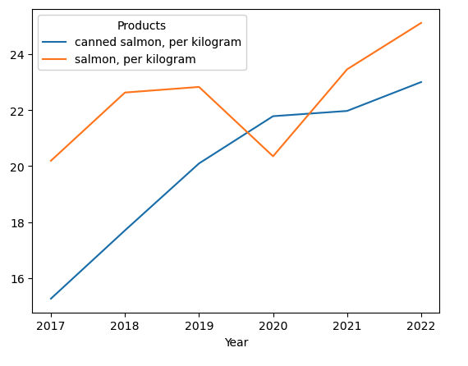
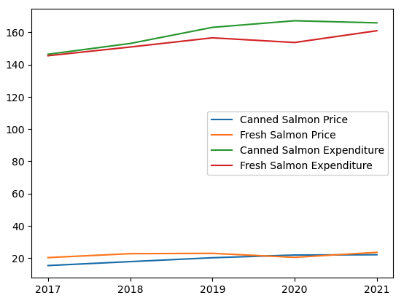
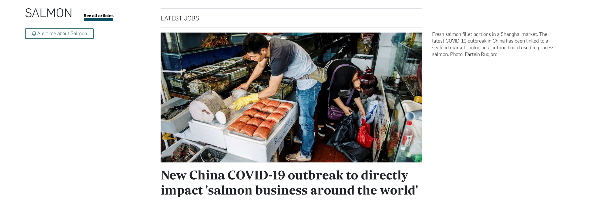
Understanding the Change of Salmon
Notes:
For better consumption of the data for the class, we choose to focus on fresh and canned salmon data as a micro example.
When looking at the graph we can see the price of fresh and canned salmon change during 6 years. When comparing the two, we can see the change in price for canned salmon increasing during the time of covid 19 while the price of fresh salmon is decreasing.
This may be due to the fact that consumers are afraid of contracting covid-19 though fresh unprocessed salmon, refer to the article clipping attached. Consumers were more inclined to trust corporations for tested food products. When looking at the graph on the right we can see the sales of canned salmon rising overtime, compared to fresh salmon.
This graph connected expenditures on salmon (fresh and canned) to their prices. It showcases canned salmon to have higher sales during covid-19 and fresh salmon sales decreasing.
Source https://www.intrafish.com/salmon/new-china-covid-19-outbreak-to-directly-impact-salmon-business-around-the-world/2-1-825710

Slide 20


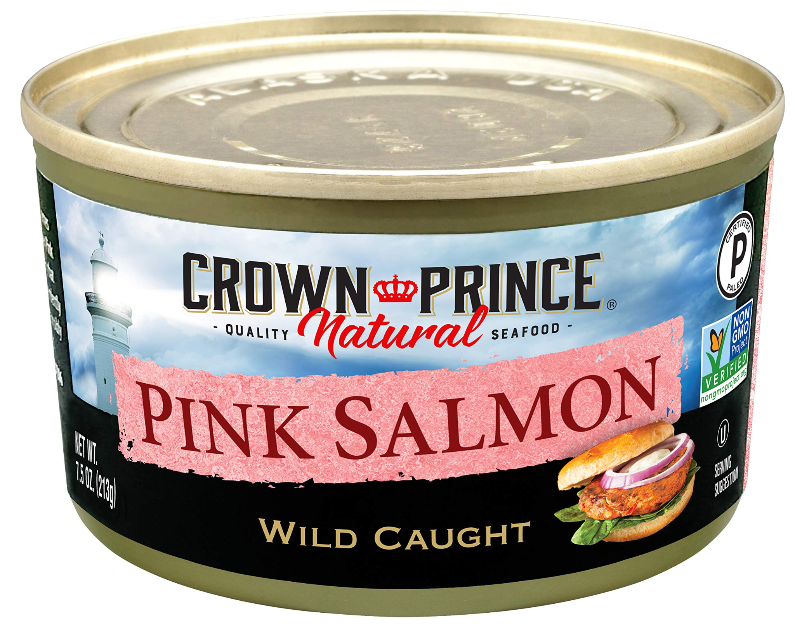
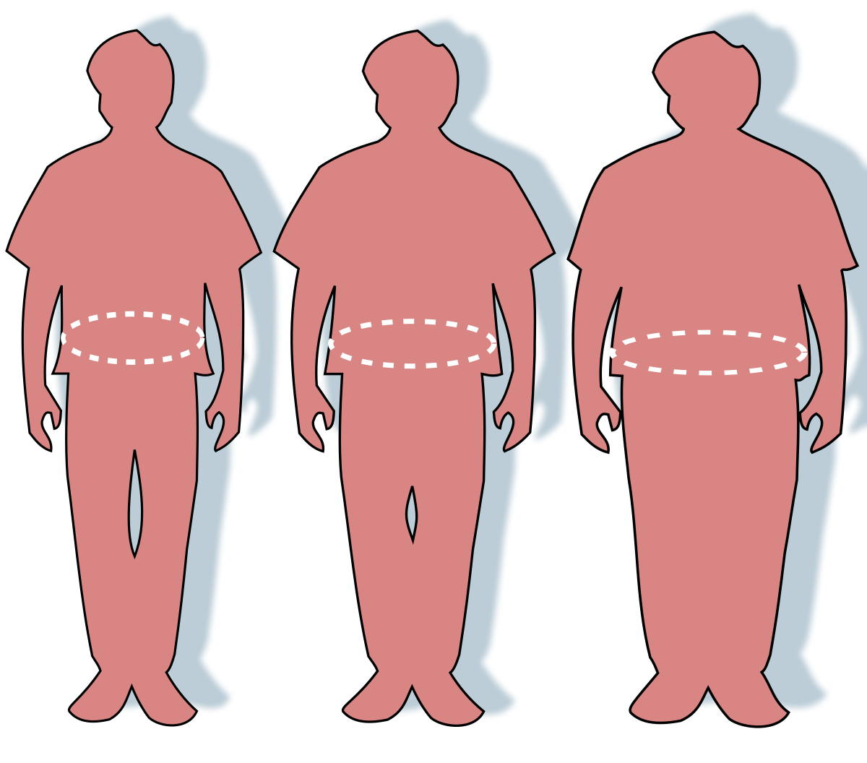


Conclusions
Notes:
In conclusion, we found that when analyzing our different data sets there were many instances where certain data points were missing or left out. An example of this was for food expenditures missing in 2018. We also noticed that due to the limitation of the breakdown structure of certain datasets, we could only analyze certain food products.
The data we chose for the class was fresh vs. canned salmon. This allowed us to draw conclusions on how covid 19 affected the outcomes. This also allowed us to view a micro example of how the increase in health food prices (fresh salmon) vs a decrease in processed food prices (canned salmon), with regards to healthy and unhealthy expenditures in the Canadian diet, namely how covid-19 affected obesity in Canada.
The next steps of this project would be to analyze the data set further and look into other micro examples and share our findings with companies. An example of a company which may find this data useful would be HelloFresh, which provides fresh meal preps at low costs, comparably lower than buying from stores. HelloFresh may find value in examining how Canadian diet and expenditure has changed over time to provide healthy meals geared toward the Canadian diets, advertise effectively and better position themselves in the industry, Thank you!

Slide 21


